Slide 1
Cross-Site Scripting Lab

Slide 2
Cross-Site Scripting Lab
Materials needed
Kali Virtual Machine (with DVWA)
Windows Virtual Machine
Software Tool used
DVWA (Damn Vulnerable Web Application)
Follow the DVWA Setup Lab if not previously installed/available on your VM

Slide 3
Objectives Covered
Security+ Objectives (SY0-501)
Objective 1.2 – Compare and contrast types of attacks
Application/Service Attacks
Cross-Site Scripting
DHS CAE Units
CTH – Describe different types of attacks and their characteristics

Slide 4
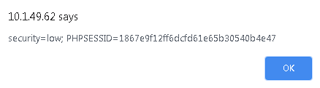
What is an Cross-Site Scripting Attack?
Inserting scripts (usually JavaScript) into a pages' HTML to bypass server access controls
Can be used to access data that should be hidden on a webpage
Why is this dangerous if the user is privileged?

Slide 5
The Cross-Site Scripting Lab
Setup environments
Access DVWA website
Lower DVWA security
XSS (Reflected)
XSS (Reflected) with HTML
XSS (Reflected) Vulnerability

Slide 6
Setup Environments
Log into your range
Open the Kali Linux and Windows 7 Environments
You should be on your Kali Linux Desktop
You should also be on your Windows 7 Desktop

Slide 7

Find the IP Address (Kali Machine)
You will need the IP address of the Kali machine
Open the Terminal
In the Linux VM, open the Terminal and type the following command:
hostname -I
This will display the IP Address
Write down the Kali VM IP address
The IP Address

Slide 8
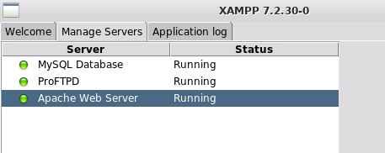
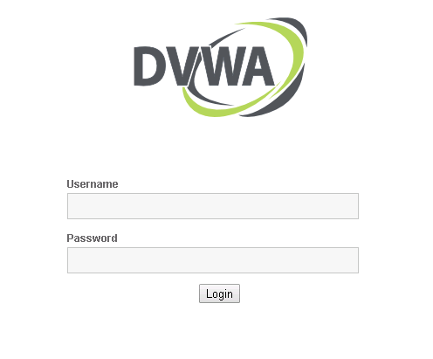
Log into DVWA
Start up the web servers (on the Kali machine)
If you used the DVWA Setup Lab, use the following command to start XAMPP (then start/restart all the servers):
sudo /opt/lampp/./manager-linux-x64.run
On the Windows Machine, go to the DVWA webpage
http://<Kali-IP-Address>/dvwa
Login credentials are admin/password

Slide 9
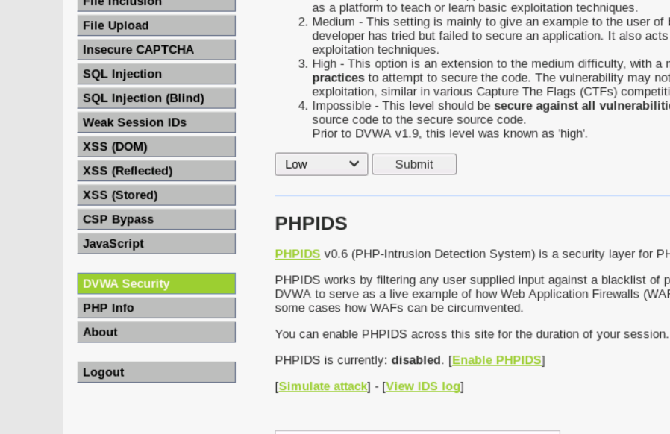
Lower DVWA’s Security
Click on the DVWA Security button
Change the security drop down option to Low
Select Submit button to set the website vulnerability
Set to Low
DVWA Security button

Slide 10

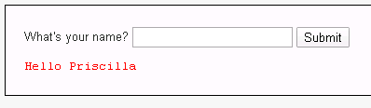
XSS (Reflected)
Click on the XSS (Reflected) Tab
You should see a “What’s your name?” prompt
Enter your name
You should see “Hello Your-Name” appear
This is how the prompt is supposed to work

Slide 11



XSS (Reflected) with HTML
Now, mess with the HTML, make the font bold
Search for <b> Your-Name </b>
You should see your name in bold font now
What if we want to change the color of the font (keep bold too)?
Search for <font color="purple"><b> Your-Name </b></font>

Slide 12
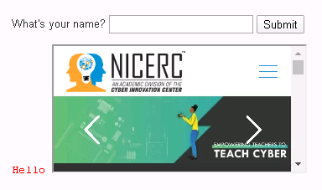

XSS (Reflected) with HTML
Now, display a website
Search for <iframe src="website-URL"></iframe>
You should see a website load in the frame
Note it may take a moment for the website to load

Slide 13

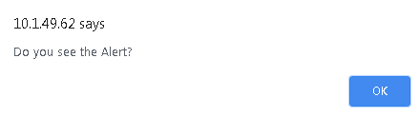
XSS (Reflected) with HTML
What if we want to display a page alert?
Search for <script>alert("Your-Message")</script>
You should see an alert appear with your message in the box

Slide 14

XSS (Reflected) Vulnerability
What is a vulnerability here?
At attacker can grab the Session ID
Obtain the Session ID
Search for <script>alert(document.cookie)</script>
This displays the cookies for the website

Slide 15
XSS (Reflected) Vulnerability
Why is obtaining the session ID bad?
What can a hacker do with this information?
The session ID is created when a user logs into the website.
Server says: "The user is authenticated. Here's a cookie so they don't have to login again and again. I'll use the session ID to remember who they are."
The session ID can be used to bypass the log-in!
What happens if a hacker obtains a session ID for someone logged into a bank’s website or some other security-sensitive organization?

Slide 16
Defending Against a Cross-Site Scripting Attack
Sanitize the inputs!
Reject inputs that are not what the search was meant for
NEVER trust user input – check it
“Escape” the user’s input
Escaping the user’s input will not run the data as HTML
Will not interpret the HTML
This will just display whatever was typed as is
Will actually display characters as they are
What is the importance of these characters: “<“ and “>” in a XSS attack?
What are some other ways of defending against a Cross-Site Scripting attack?

